Slide 1
Do Diets 1 & 2 Yield Different Growth?
A statistical analysis for the farm industry

Slide 2
Executive summary
Definition of the problem («is there a statistical difference between the growth of the group Diet 1 and the group Diet 2?», source of data: chickweight.csv)
Visualizations, preliminary tests and statistic test.
Conclusions (No significant difference between the groups, choose diet by cost).
Documentation: requirements.txt, readme.txt, LICENSE.txt and the Jupyter notebook.

Slide 3
Definition of the problem and goal
The parameters of the dataset are the ID number of the chickens, the number of the diet, the weight of chickens (in grams) and the day when the measure was taken.
I want to understand if there is a statistical difference between the growth of the chickens of the group Diet 1 and the growth of the chickens the group Diet 2 over these 21 days.

Slide 4
Null hypothesis and coding tools
The initial null hypothesis is that there is no statistical difference between these two groups.
In order to analyze the data Python will be used, in particular the libraries Pandas (for data analysis), SciPy (for statistics) and matplotlib (for data visualization).

Slide 5
Initial steps and data cleaning
The vectors associated to the growth are defined as the difference between the weights at day 21 and the weights at day 0.
There are 4 missing values in the first group related to the weight of the day 21. Hence they are removed (first group n₁ =16, second group n₂ =10).

Slide 6
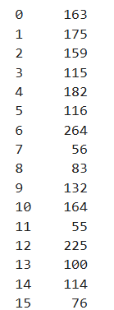
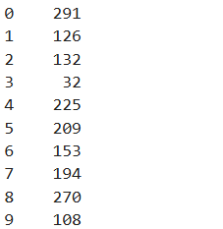
Data on the growth for the two groups

Slide 7
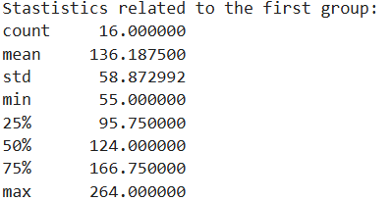
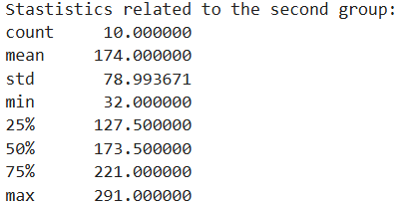
Statistics on the growth

Slide 8
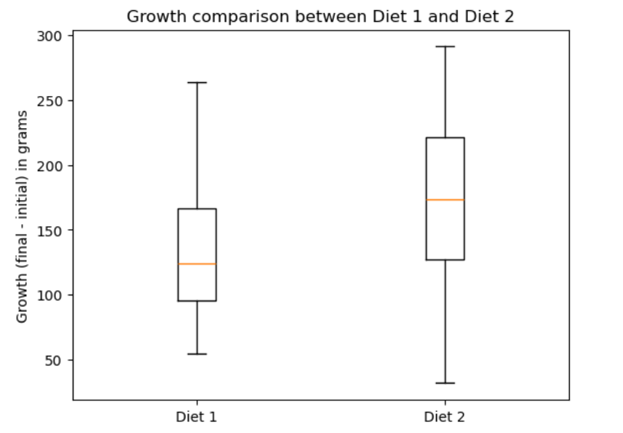
Boxplots of the distributions
Both diets show similar distributions, Diet 2 is a bit more spread.
No outliers detected.

Slide 9
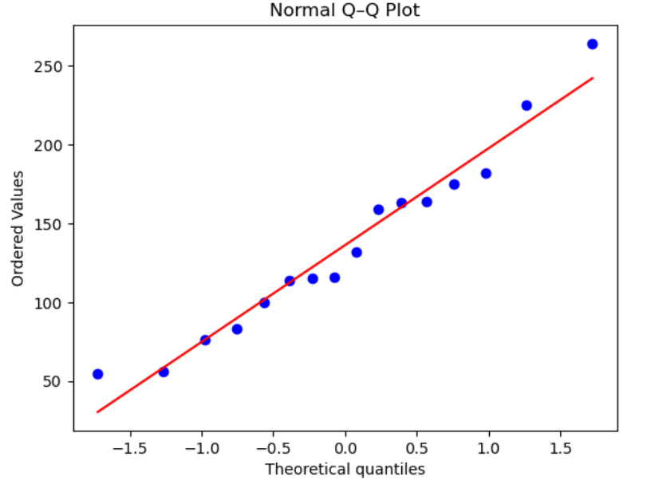
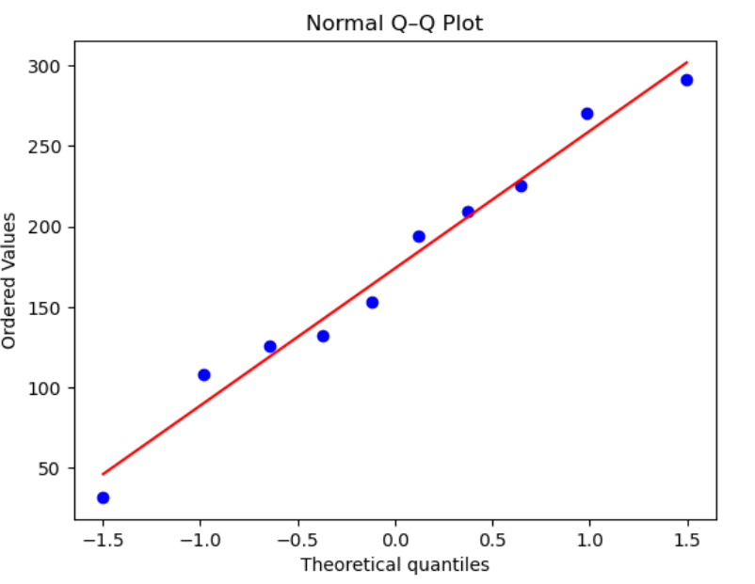
Q-Q plots
Diet 1, similar to normal distribution
Diet 2, similar to normal distribution

Slide 10
Shapiro-Wilk test
The data of both groups seem distributed normally. To confirm the normality Shapiro-Wilk test will be used.
In order to accept or not the normality hypotesis we will use the idea of p-value (i.e. the probability, assuming the null hypothesis is true, of getting results at least as extreme as the ones observed). In general if the p-value is smaller than 0.05 the null hypothesis will be rejected.

Slide 11
Choosing the statistical test
The normality of the samples and their independence between each other are crucial hypotheses to apply Welch’s t-test.
I prefer Welch to Student’s t-test since the variances are s₁² = 3466 and s₂² = 6240. Levene or similar test may be also not enough powerful.

Slide 12
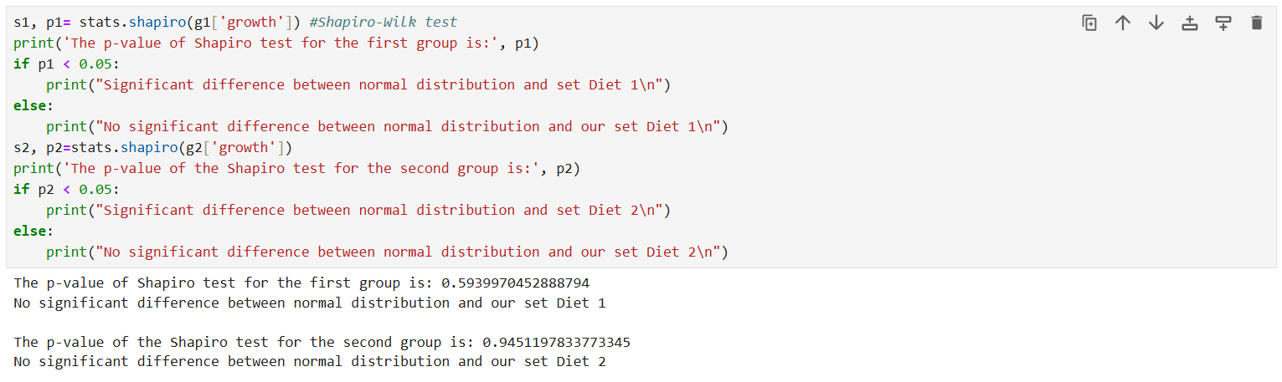
Preliminary results

Slide 13
Welch’s t-test
No strong evidence against normality (p₁-value=0.59, p₂-value=0.945, Q-Q plots).
Samples are independent by design.
The dimension of samples are different and small (n₁=16, n₂=10).
so
I applied the Welch’s t-test.

Slide 14
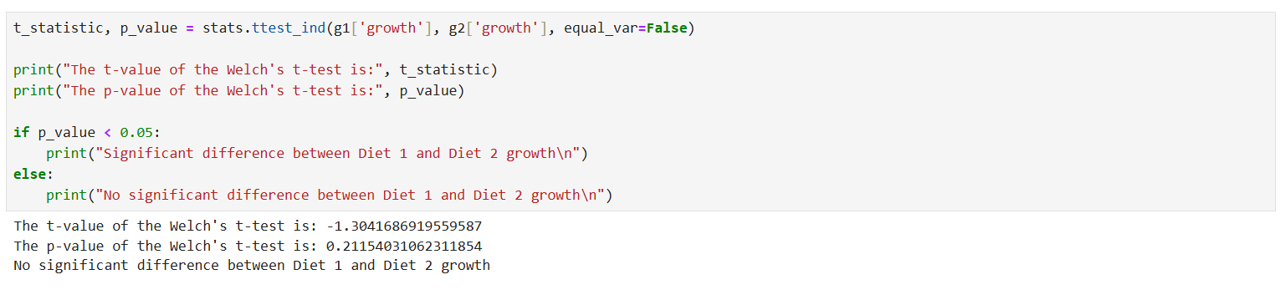
Results of the t-test

Slide 15
Confidence intervals
It is useful also to compute the confidence intervals related to these two samples.
If 0 lies within the CI, then there is not significant difference between Diet 1 and Diet 2 growth.

Slide 16
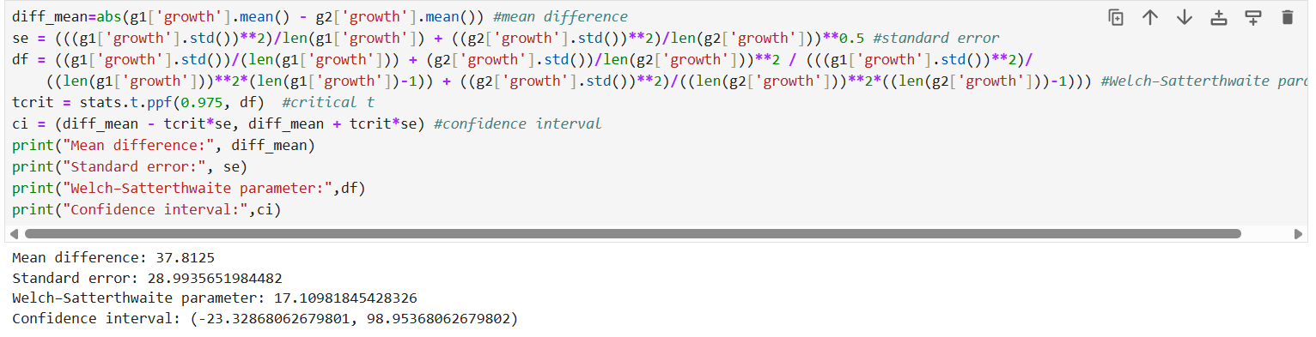
Compute 95% CI

Slide 17
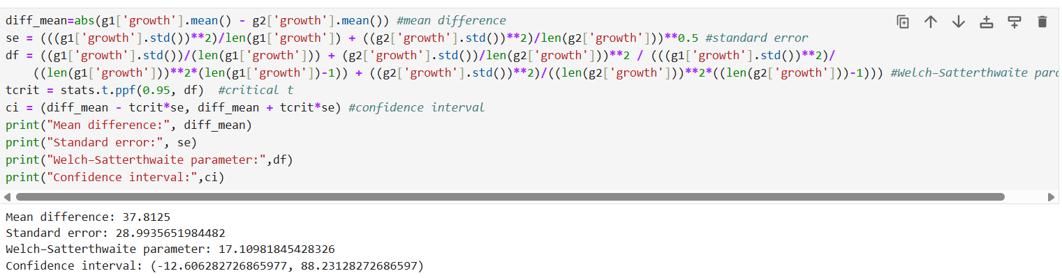
Compute 90% CI

Slide 18
Conclusions
p-value of the test=0.21,
Confidence intervals, 95% CI=[-23.3,98.8], 90% CI=[−12.6, 88.2]
Mean difference=37.8 g
so
No significant growth difference between Diet 1 and Diet 2, but more data are needed to confirm the result.

Slide 19
Key Takeaways
No significant growth difference between Diet 1 and Diet 2.
Small dataset, expand it with more features.
Recommendation: choose diet based on cost and other factors (37.8 g mean difference may have a financial impact depending on cost of feed, check bias Group 1).

Slide 20
Thank you!

